Slide 1
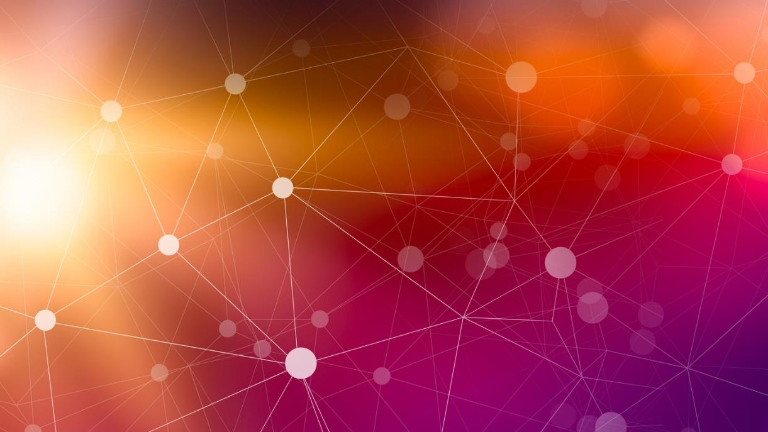
DDD and Event Sourcing

Slide 2
Domain Events Bringing EDA to the Solution Level
Notes:
Domain Events come from DDD
It’s how we bring EDA down to the solution level
They are what make Event Sourcing “Practical”
You can do Event Sourcing w/o DDD, but it’s a lot more “messy” and less explicit

Slide 3
What is a Domain Event?
Immutable representation of something that has happened in the past that can be used to trigger additional behavior (side-effects) within the same domain that the event was raised in.

Slide 4
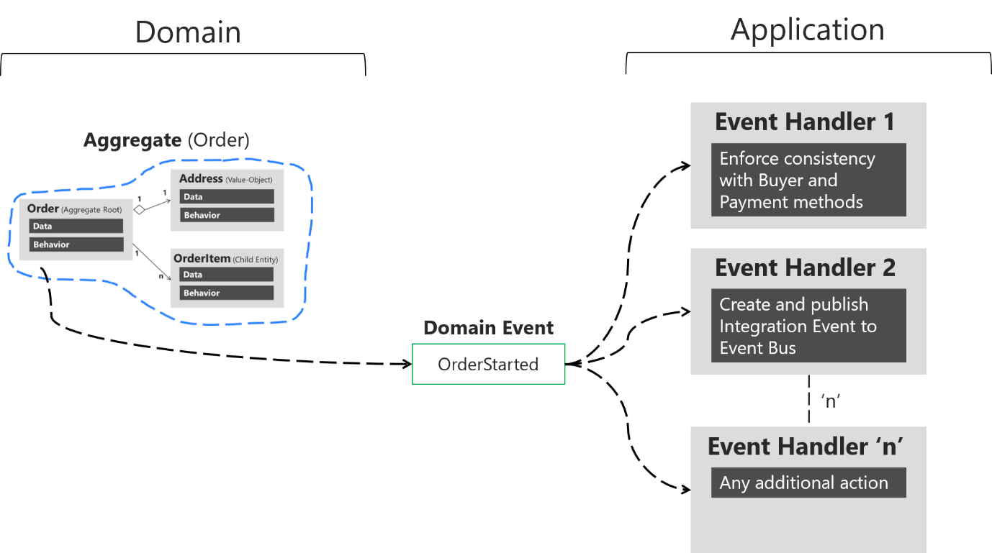
Domain events: Design and implementation - .NET | Microsoft Learn
Notes:
User sends a request or command to “start” an order
That Order then creates and raises an “OrderStarted” event WITHIN the domain, typically using something like MediatR
Any number handlers, responsible for a single “side-effect”

Slide 5
Why Domain Events?
Decouple “Side-Effects” from the Original Command (SRP)
Additional behaviors/side-effects are more explicitly modeled
Extensibility – New features can be introduced w/o modifying existing code (Open/Closed Principle)
Sets us up beautifully for Event Sourcing
Notes:
As additional business rules and side-effects grow, are code becomes tightly glued together and a single class becomes responsible for handling all these additional behaviors, violating SRP
2. Clearly understand the “consequences” of a command or request

Slide 6
Why Domain Events?
Decouple “Side-Effects” from the Original Command (SRP)
Additional behaviors/side-effects are more explicitly modeled
Extensibility – New features can be introduced w/o modifying existing code (Open/Closed Principle)
Sets us up beautifully for Event Sourcing
Notes:
As additional business rules and side-effects grow, are code becomes tightly glued together and a single class becomes responsible for handling all these additional behaviors, violating SRP
2. Clearly understand the “consequences” of a command or request

Slide 7

Event Sourcing

Slide 8
Event Streams
Add Item Request
Item Added
Item Removed
Order
Apply Business Rules/Raise Domain Event
Status Change
Item Added
Event Stream

Slide 9
Reading Data
Item Added
Item Removed
Status Change
Item Added

Slide 10
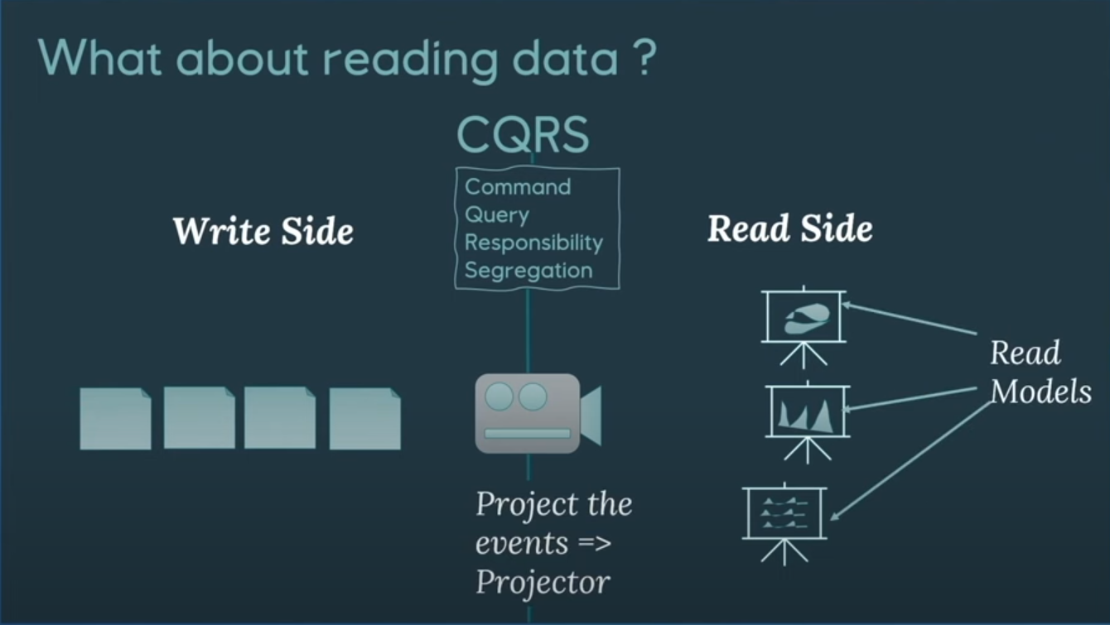
Event Sourcing – the what, why & how - Anita Kvamme - NDC Oslo 2024 (youtube.com)

Slide 11
Why Event Sourcing?
Never lose any data/complete history of aggregate
Fulfills “Visibility” Requirement
Easier to extend
New Events
Read Models
Debugging – event stream gives us what changes have been made
In memory read models?
Notes:
2. Tells us where it’s been, where it’s at, and how it got there

Slide 12
Event Sourcing Challenges
New way of thinking/modeling application. Will be more difficult for new developers
Eventual Consistency
Complexity
Concurrency?
Notes:
2. Eventual Consistency – how long can the user go before they see their change? Ways around this. Ex. Show user their change immediately
3. Lot’s more moving parts, harder to see the big picture

Slide 13

Implementation

Slide 14




Write Side
Domain
Model
Domain
Model
Event Handler
Service Bus
Event Handler
Event Store
Command
Application Service (Command Handler)
Event Handler
Read Model
Create/Update
Projection

Slide 15
Read Side
Query
Application Service (Query Handler)
Read Model

Slide 16
Read Side
Query
Read Model

Slide 17
Summary
Domain
Model
Domain
Model
Event Handler(s)
Service Bus
Event Store
Command
Application Service (Command Handler)
Read Model
CosmosDB Trigger
Query

Slide 18
Demo

Slide 19

That’s it!

